Slide 1
FOIA Basics and Best Practices for Depository Libraries
April 21, 2017
ALINA M. SEMO, Director
AMY BENNETT, Management and Program Analyst
Office of Government Information Services

Slide 2
What we’ll cover today
What is FOIA?
How do I file a FOIA?
Where can I find help with my FOIA request?
What is OGIS’ role in FOIA?

Slide 3
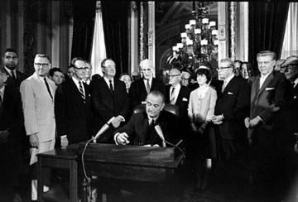
FOIA Basics

Slide 4
FOIA Basics
Nine exemptions
Proactive disclosure requirements and electronic reading rooms
Time limits
Fees and fee waivers
Administrative appeals process
Right of action in District Court

Slide 5
FOIA Fast Facts: FY 2016
115 Federal Agencies Subject to FOIA
More than ¾ of a million requests received
4,263 Full Time FOIA Staff
Agencies collected less than one percent of reported FOIA costs in fees

Slide 6
FOIA Basics
How does it work?
What can I expect?

Slide 7
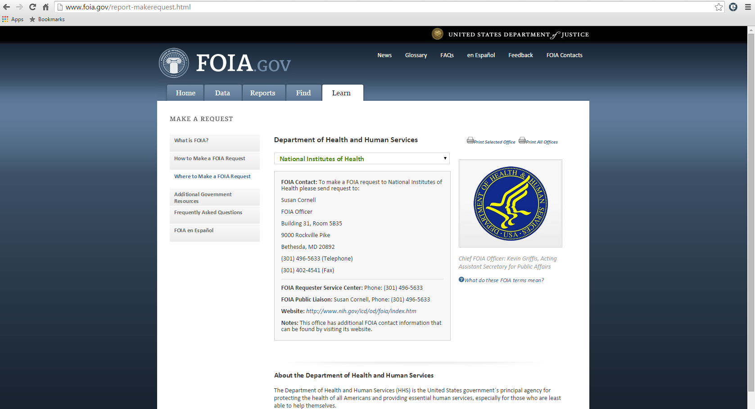
Making a Request

Slide 8
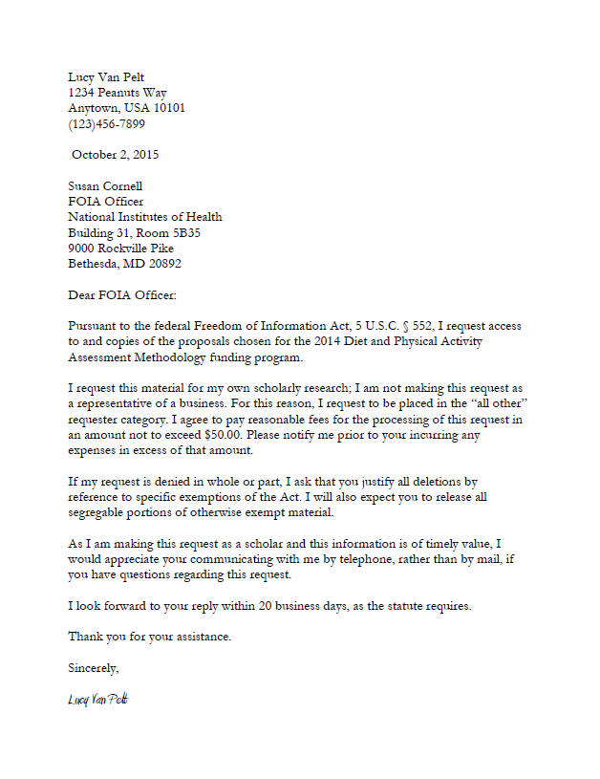
Making a Request

Slide 9

Making a Request
Step 1: Describe the Records

Slide 10

Making a Request
Step 2: Address Fees
Agreement to pay
Fee category
Fee waiver

Slide 11
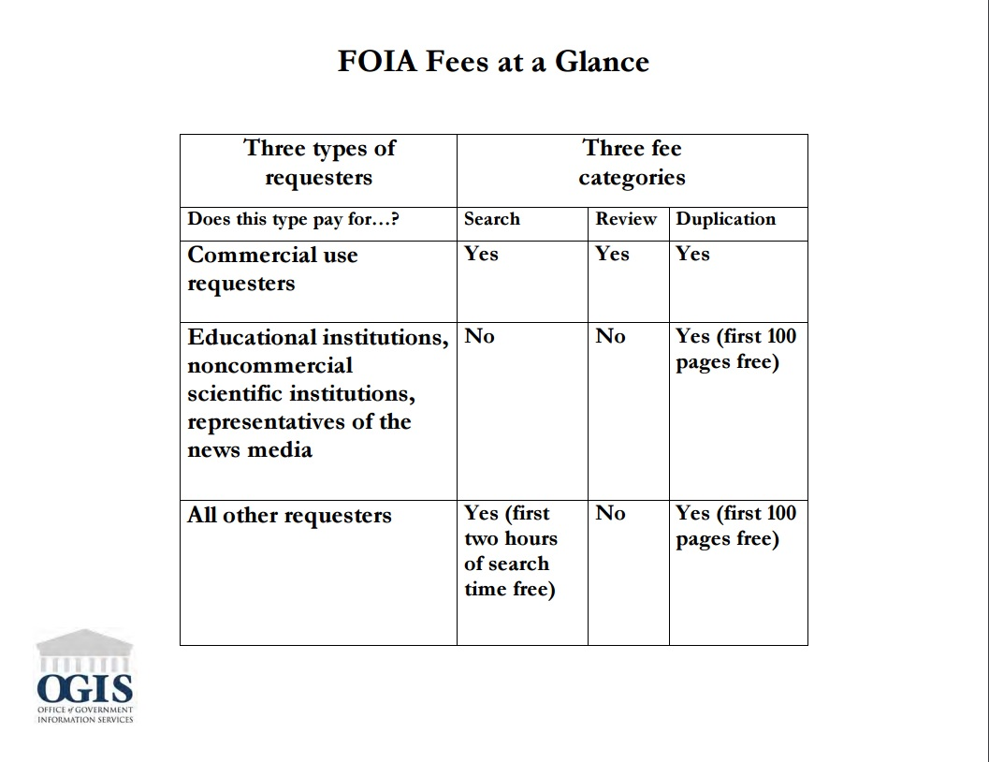
Making a Request

Slide 12

Making a Request
Step 3: Provide contact information

Slide 13
What to Expect
Acknowledgement letter
  Tracking number
Possible request to clarify or narrow scope
Possible notice of “unusual circumstances”
Agency Response

Slide 14
Administrative Appeals
90-day deadline
Directions should be in the agency’s response letter, review agency regulation if needed
Can appeal the thoroughness of the search, fee issues, redactions

Slide 15
Where to Find Assistance
General Guidance (an incomplete list)
  FOIA.gov and Department of Justice FOIA Guide
  Citizen’s Guide to Using FOIA (House Oversight and Government Reform)
  FOIAwiki

Slide 16
Where to Find Assistance
Dispute Resolution Services
  Agency FOIA Public Liaisons
  Office of Government Information Services (OGIS)
    Alternative to litigation, does not preclude litigation
    Neutral
    Voluntary process

Slide 17
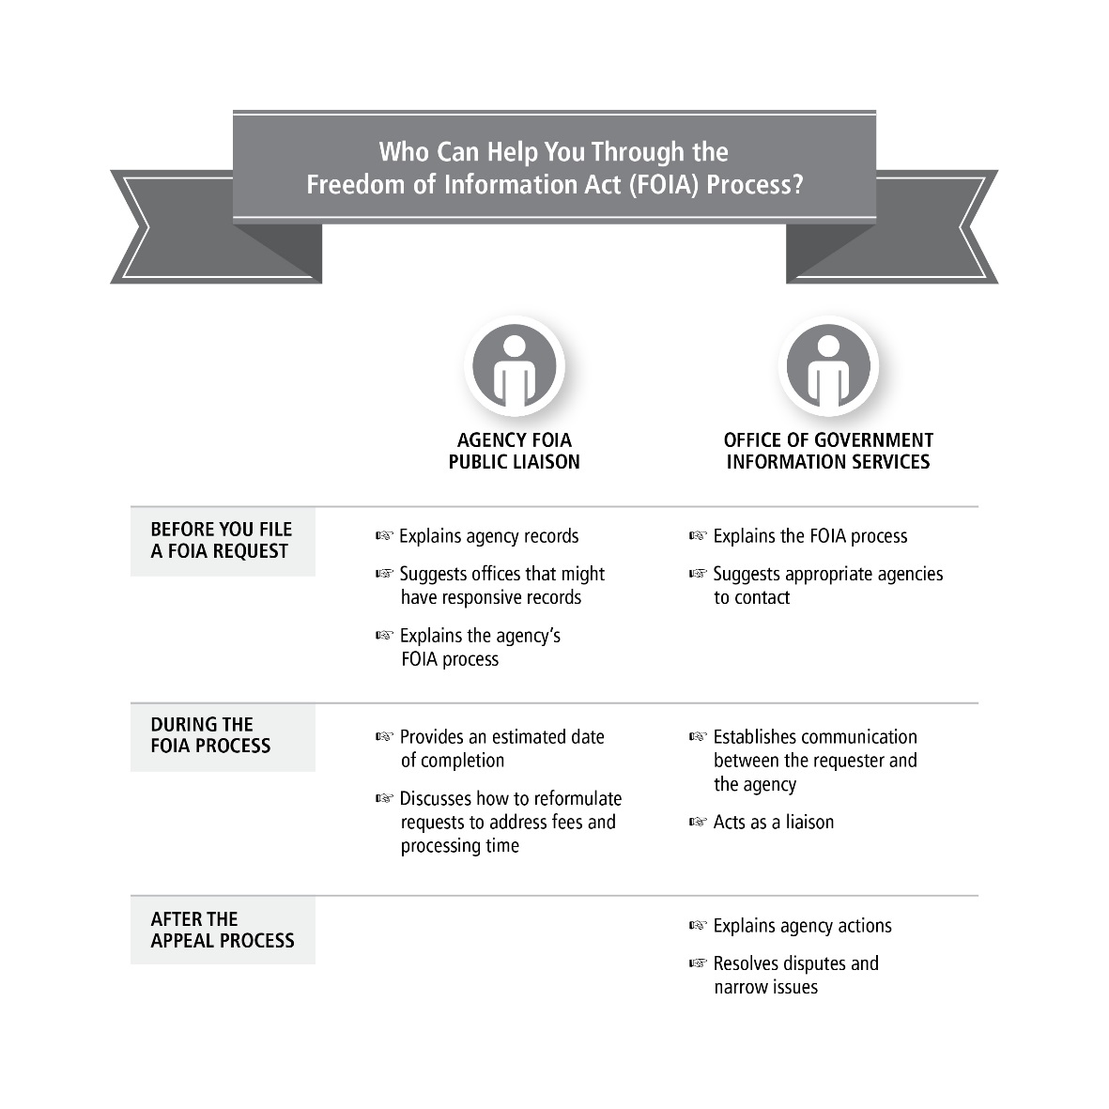
Where to Find Assistance

Slide 18
OGIS
FOIA Ombudsman
Provide dispute resolution services to resolve FOIA disputes
Review agencies’ FOIA policies and procedures & identify procedures and methods for improving compliance

Slide 19
OGIS Compliance Review
Agency Assessments
  Complete: National Archives, Department of Homeland Security
  Ongoing: Consumer Financial Protection Bureau
  Scheduled: United States Postal Service and USCIS
Issue Assessments
Self-Assessments

Slide 20
OGIS Continued
FOIA Advisory Committee, Chair
Chief FOIA Officers Council, Co-Chair
Annual Open Meeting
Annual Report
Sunshine Week at the National Archives
Social Media

Slide 21
Contact OGIS
www.ogis.archives.gov
OGIS@nara.gov
(202) 741-5770
(877) 684-6448
@FOIA_ombuds
https://foia.blogs.archives.gov

