Slide 1
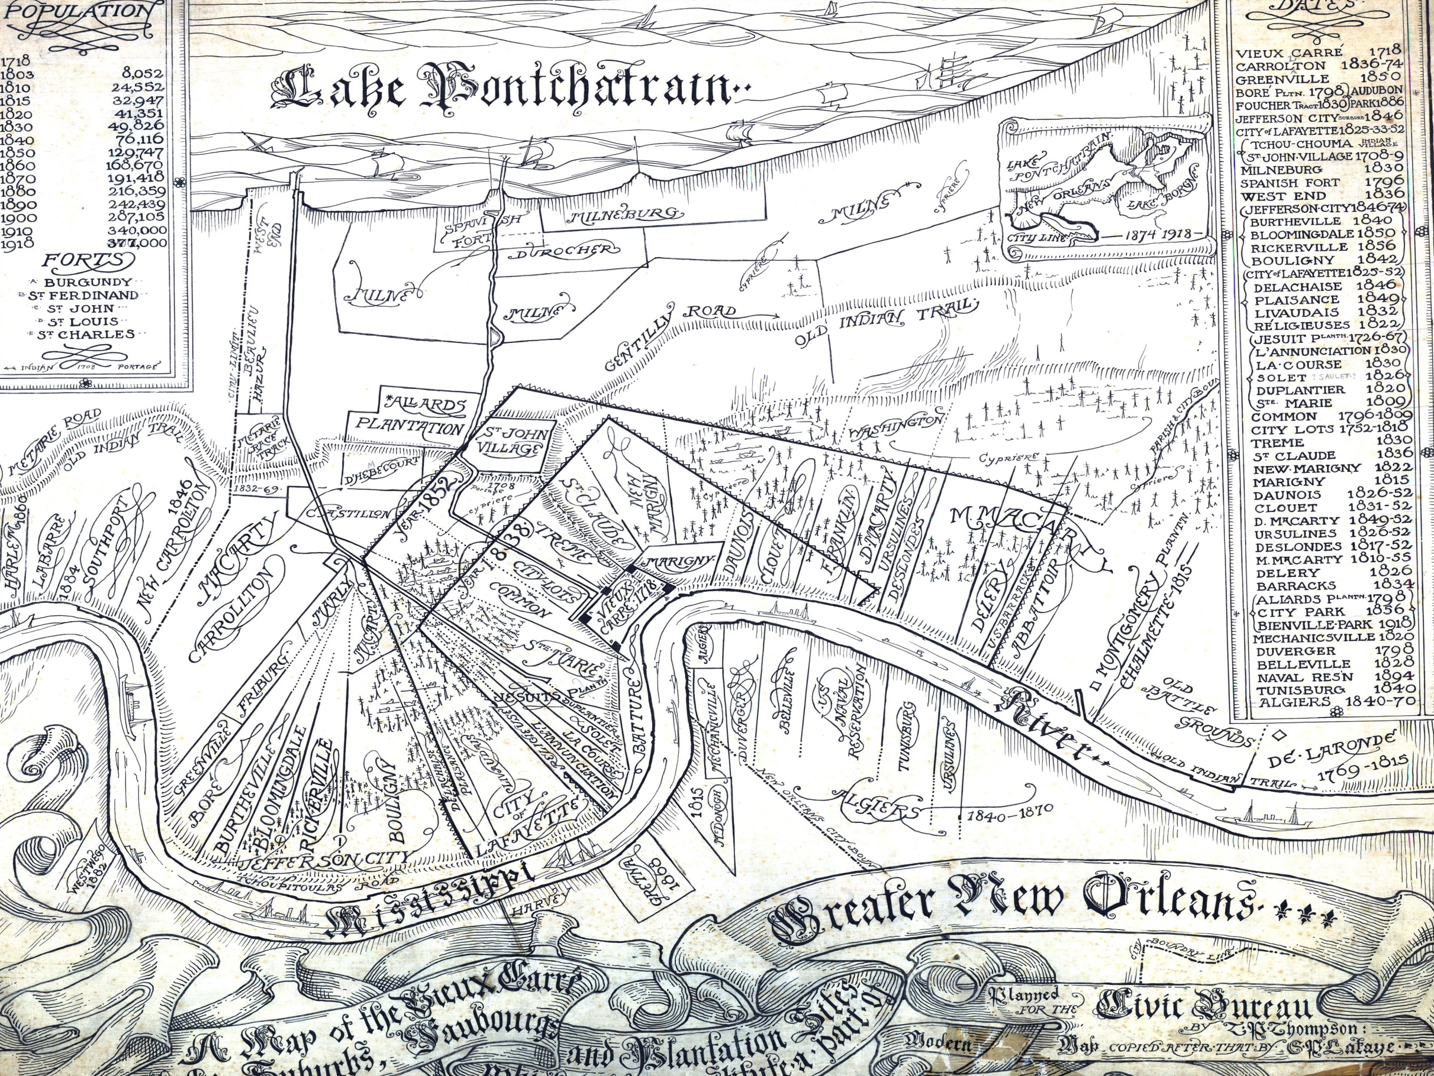
Denice W. Ross
Public Interest Technology Fellow
New America
Post-Katrina New Orleans:
A Case Study of a World without Government Data
@denicewross

Slide 2
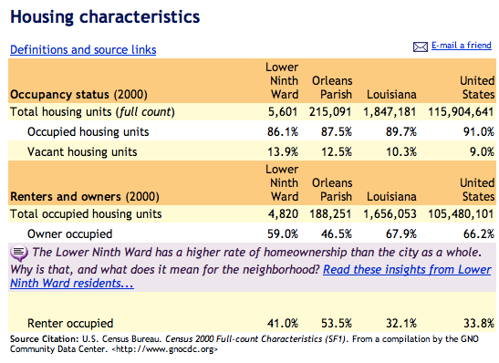

Slide 3
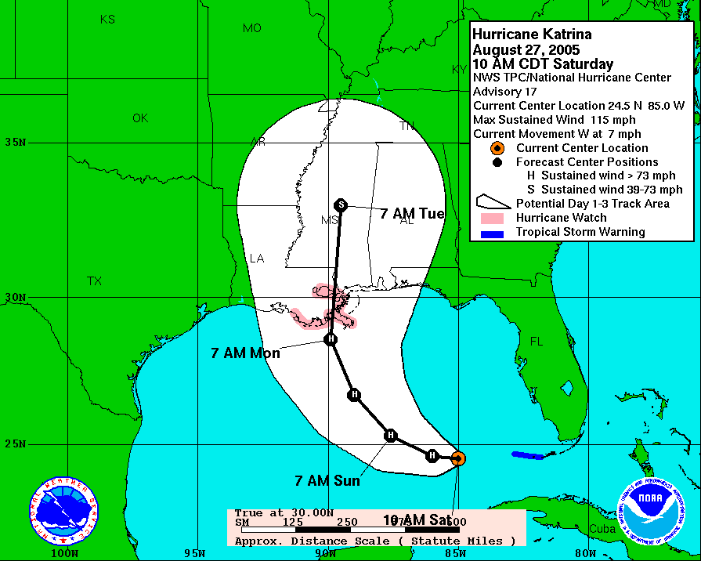

Slide 4
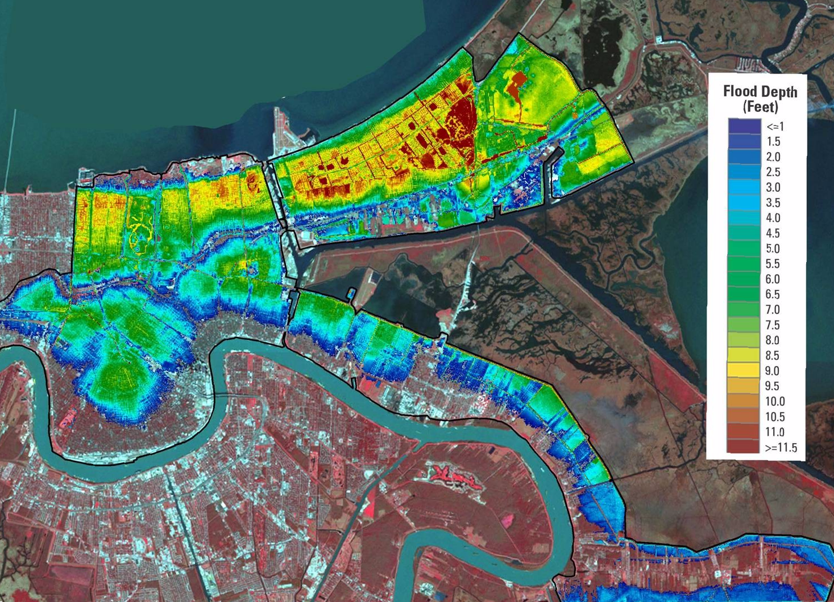

Slide 5
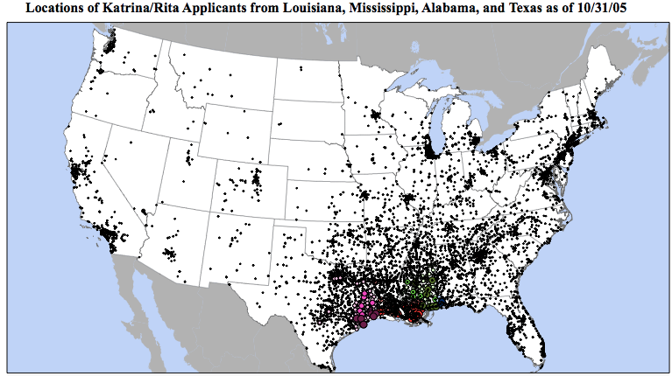


Slide 6

…Matt Fellowes of the Brookings Institution in Washington, which will soon begin publishing a Katrina Index on the rebuilding effort, said it had been easier gathering data for Iraq than for New Orleans.

Slide 7
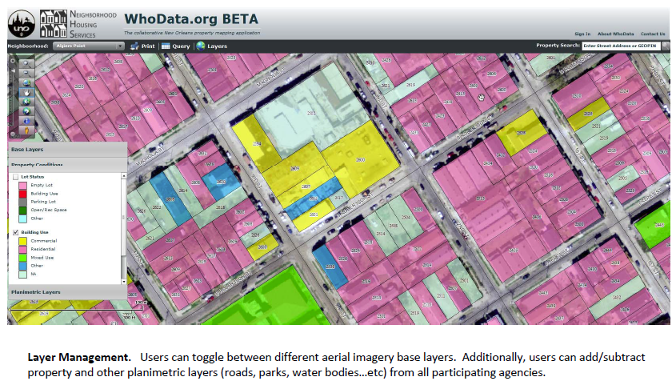
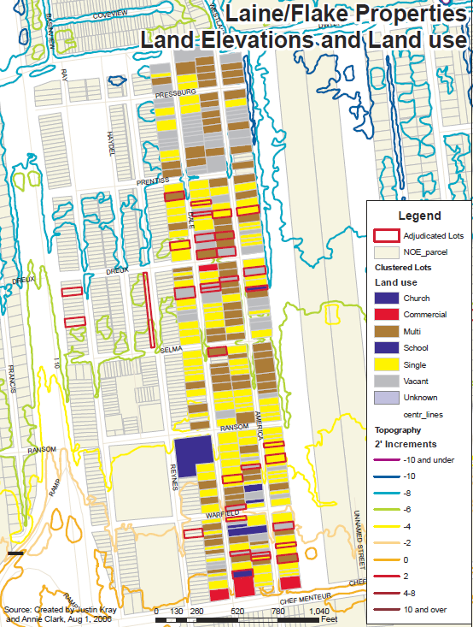
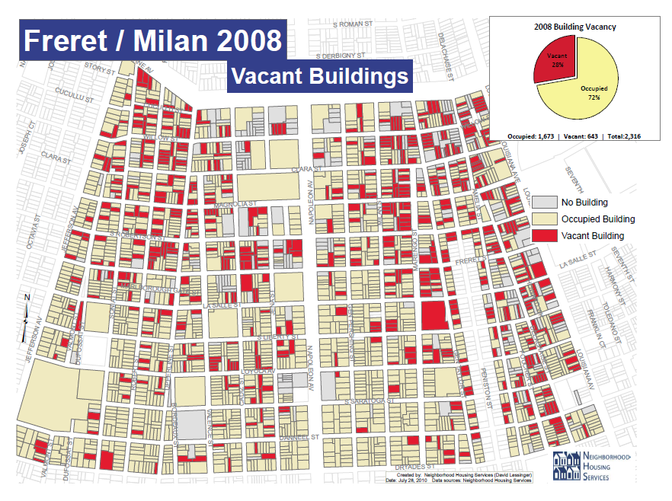
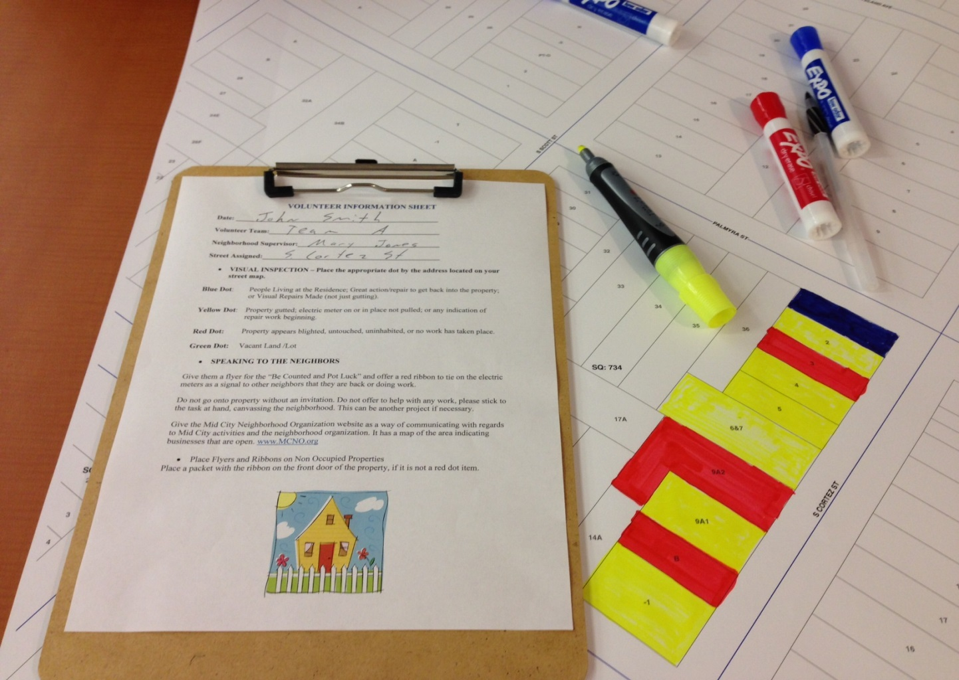

Slide 8
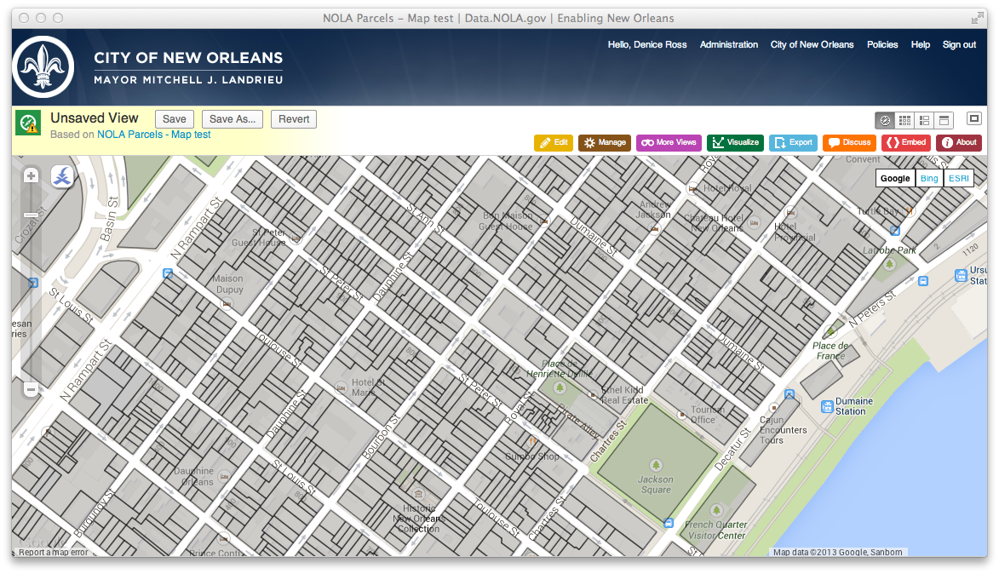

The “Official” City Parcel Layer

Slide 9

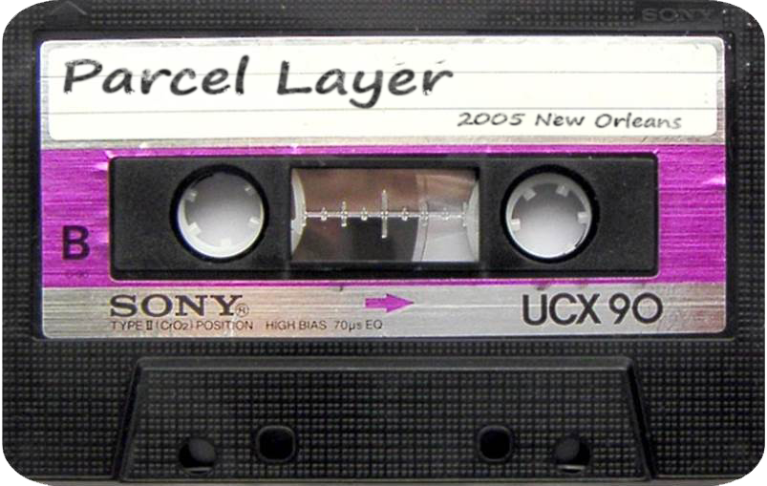

Slide 10
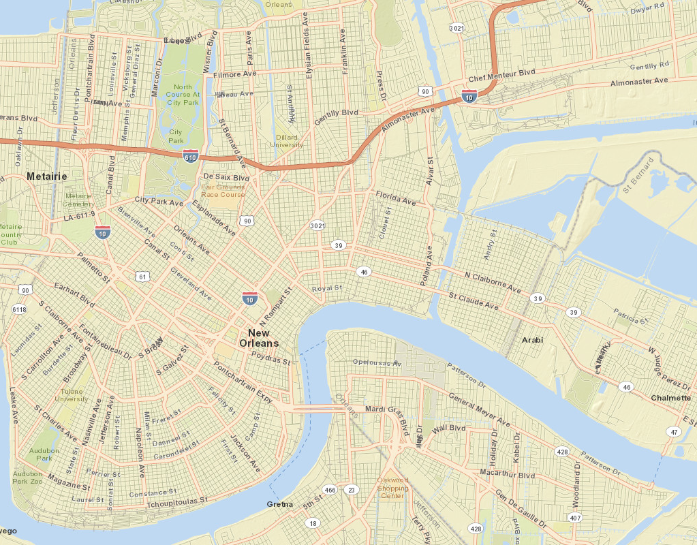



Slide 11



Notes:
Valassis, a direct mail marking company, donated this postal data to us. We made a web app to display the data – and the metadata.

Slide 12
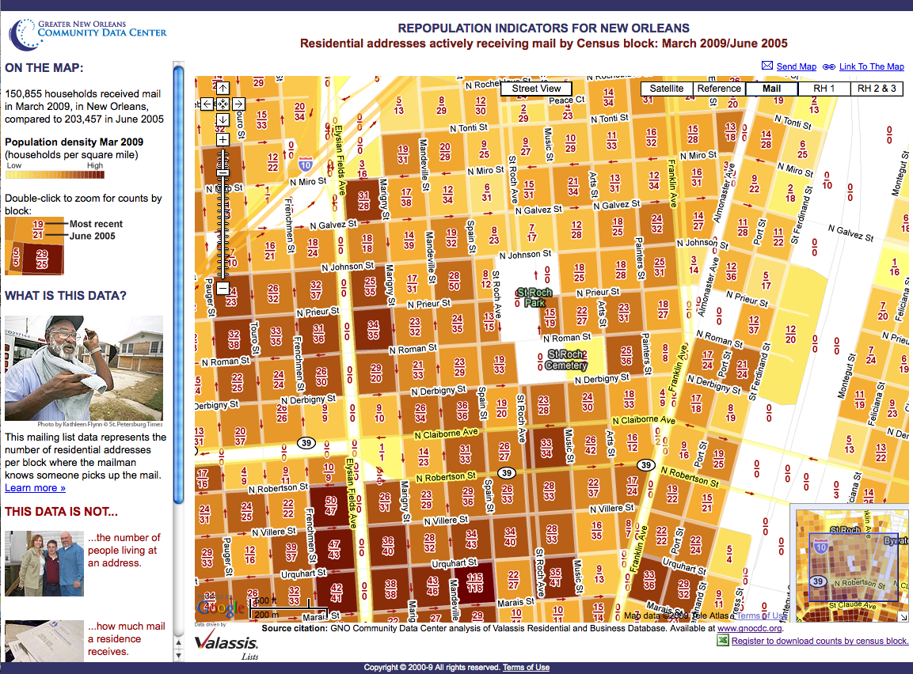

Slide 13


Slide 14
Opportunities in this moment
Encourage enthusiastic and prominent citation of federal data sources
Build capacity of people and communities to use federal data
Make a plan B for data communities need, in case federal sources dry up
@denicewross

